Slide 1
CMPE 202 Code For Fun
By Amit Bharadia, Dharma Dheeraj Chintala

Slide 2
USECASE Diagrams

Slide 3
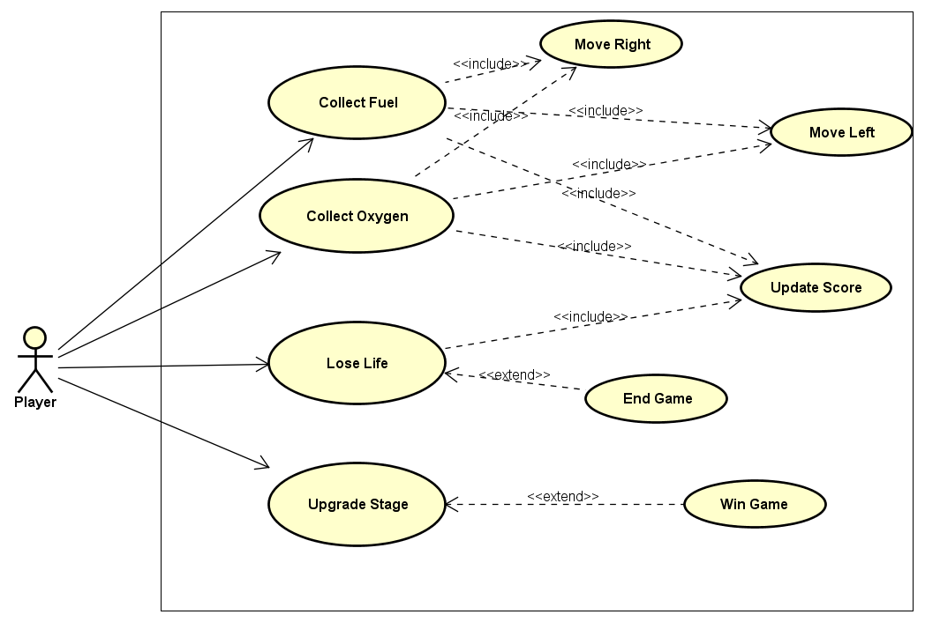

Slide 4
Class Diagrams

Slide 5
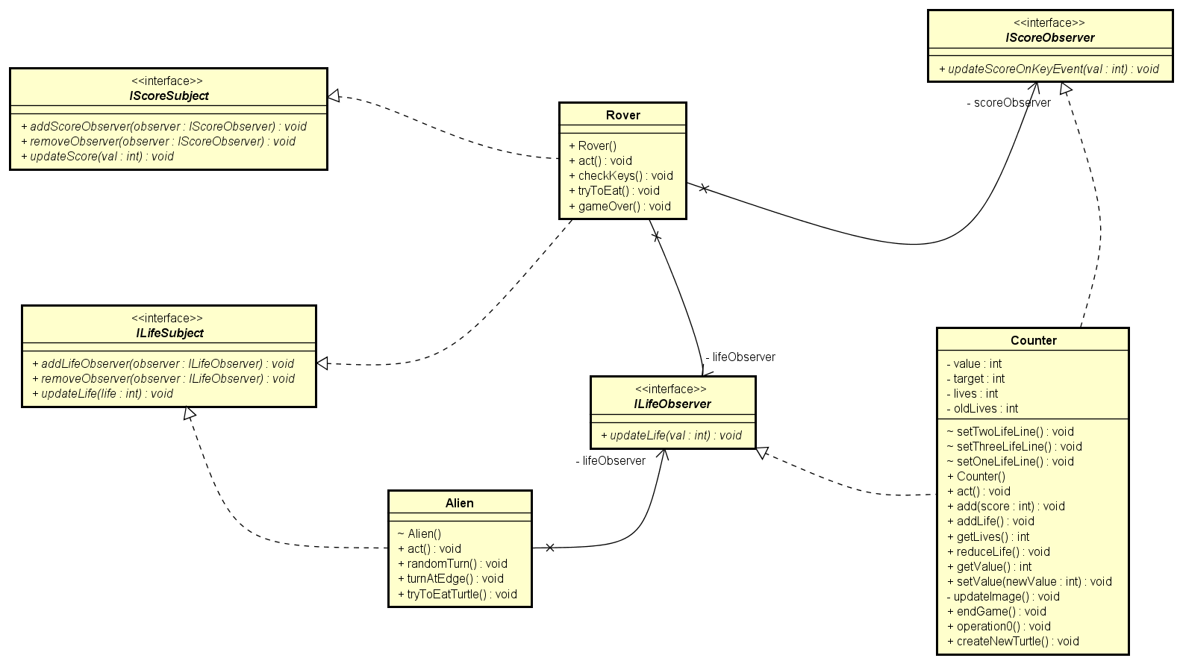
Observer Pattern

Slide 6
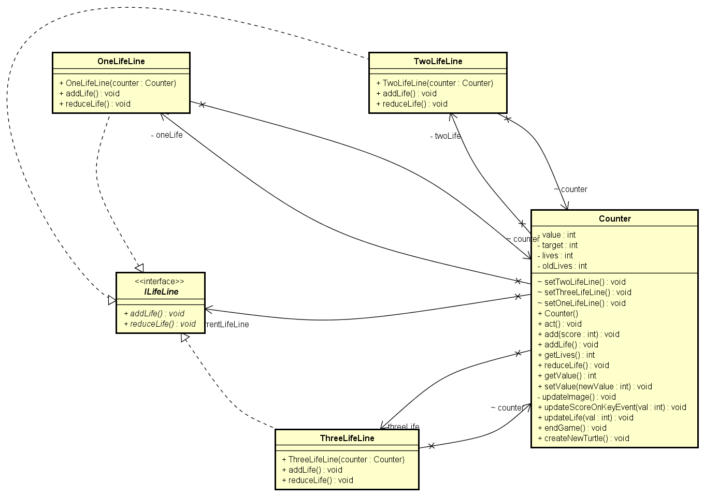
State Pattern

Slide 7
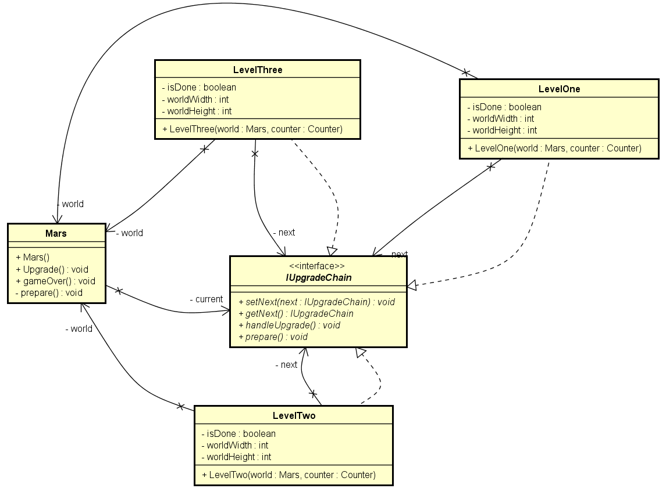
Chain of Responsibility Pattern

Slide 8
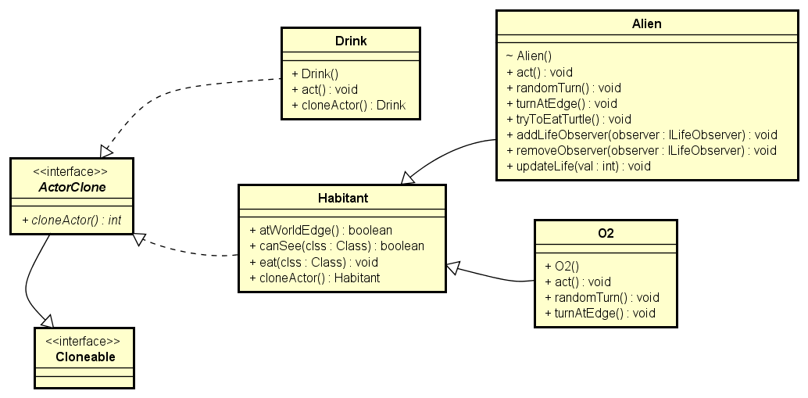
PrototypePattern

Slide 9
Activity Diagrams

Slide 10
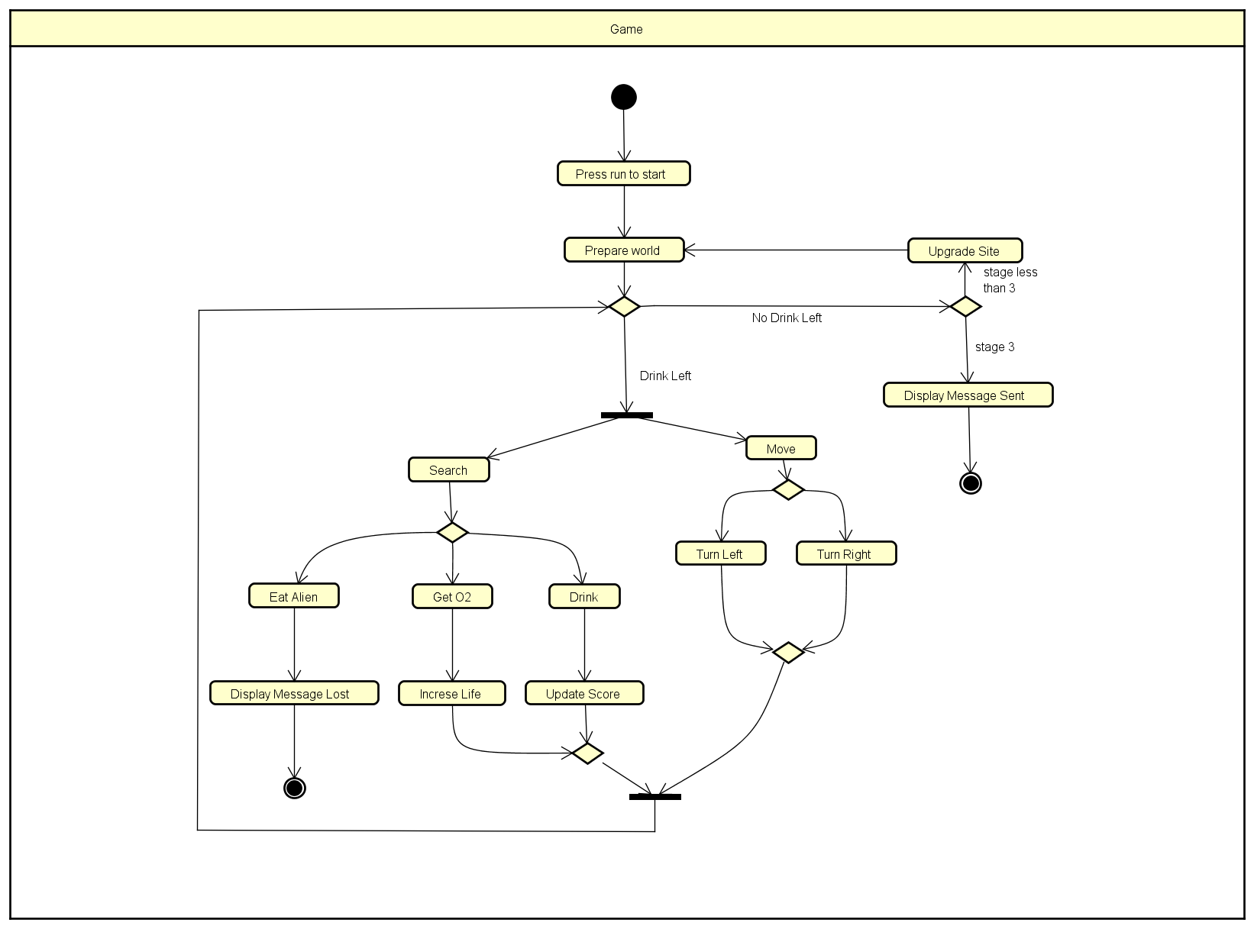

Slide 11
SEQUENCE Diagrams

Slide 12
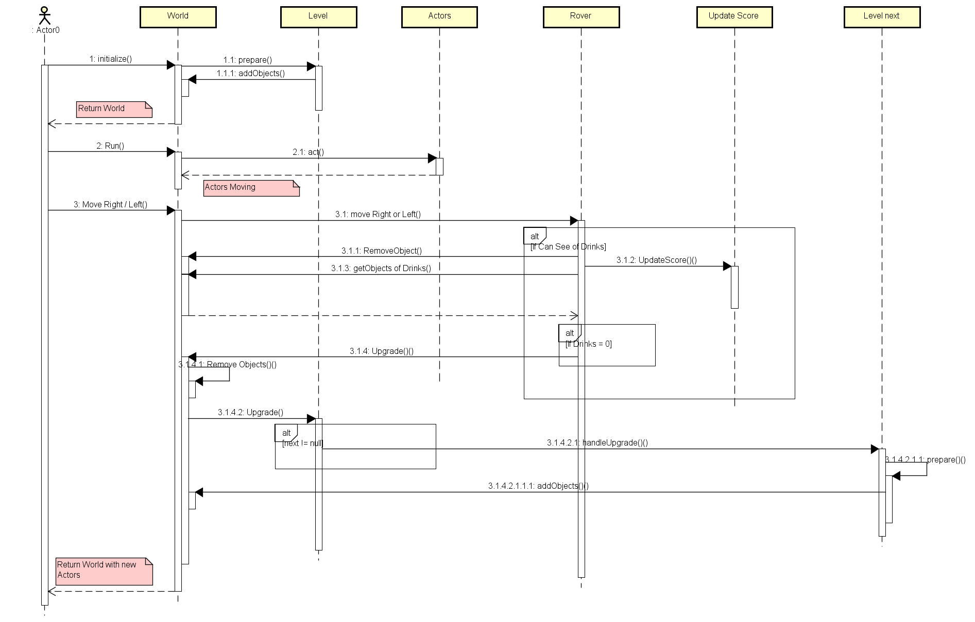
Level Upgrade

Slide 13
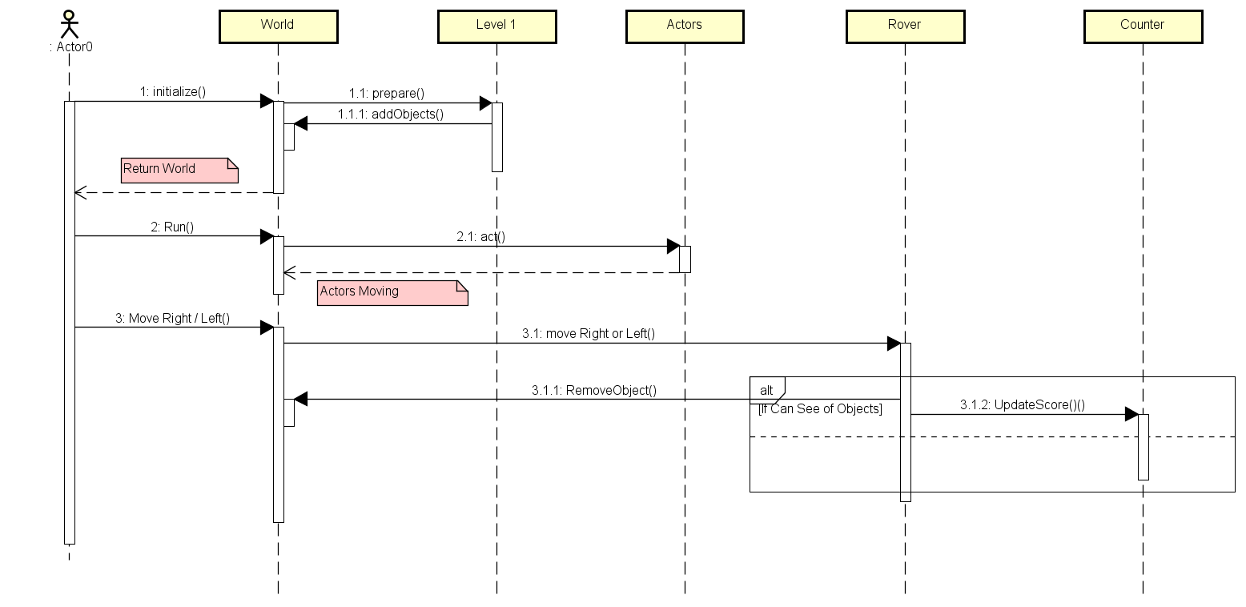
Upgrade Score

Slide 14
Burn down Chart

Slide 15
Scrum BOARD

Slide 16
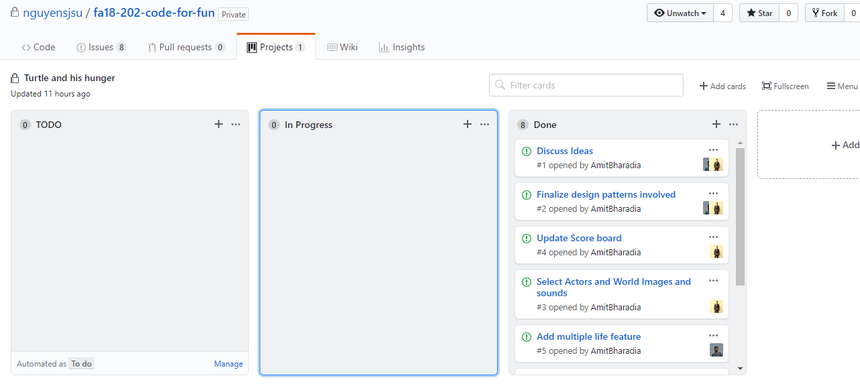

Slide 17
Links to our Github Repo
https://git
Link to our Team’s Project Board(on Github)
htt
Link to our Team’s Project Journal(on Github)
https://g
Link to our Team’s Sprint Task Sheet
https:/
Link to our Team’s Ad Video on Youtube:

